Slide 1


AWS Cloud Project
A hands-on demonstration of my cloud computing skills on the AWS Cloud Platform.
Livingstone Bvumbi

Slide 2
Real world implementation of aws cloud services to provision a secure , highly available and scalable enterprise system architecture.
A secure, load-balanced, auto-scaling distributed system deployed in a multi-AZ VPC
AWS Services provisioned:
EC2 – Ubuntu Linux on SSD, t2.micro
Application Load Balancer
VPC
Auto-scaling Groups
NAT Gateway
Security Groups

Slide 3

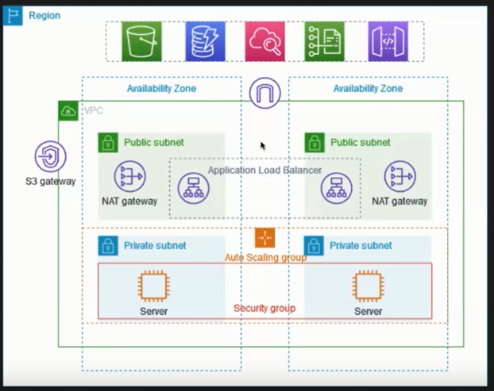
System Topology
1 Region
2 Availability Zones
1 VPC
Public and Private subnets
Application Load Balancer
Auto Scaling Group
Security Group
2 NAT Gateways
2 EC2 Instances

Slide 4

System overview
The VPC has public and private subnets in two Availability Zones.
- Each public subnet contains a NAT gateway and a load balancer node.
- The servers run in the private subnets, are launched and terminated by using an Auto Scaling Group, and receive traffic from the Application Load Balancer.
- The servers in the secure private subnets can connect to the internet by using the NAT gateway

Slide 5
Project steps
Secure VPC Setup with EC2 Instances
Create a VPC with custom IP ranges. Set up public and private subnets. Configure route tables and associate subnets..
Set up network access control lists (ACLs) to control inbound and outbound traffic. Configure security groups for EC2 instances to allow specific ports and protocols.
Launch EC2 instances in both the public and private subnets. Configure security groups for the instances to allow necessary traffic. Create and assign IAM roles to the instances with appropriate permissions.
Set up an internet gateway to allow internet access for instances in the public subnet. Configure NAT gateway or NAT instance to enable outbound internet access for instances in the private subnet. Create appropriate route tables and associate them with the subnets.
Generate an SSH key pair and securely store the private key. Configure the instances to allow SSH access only with the generated key pair. Implement IAM policies and roles to control access and permissions to AWS resources.
SSH into the EC2 instances using the private key and verify connectivity. Test network connectivity between instances in different subnets. Validate security group rules and network ACL settings.

Slide 6
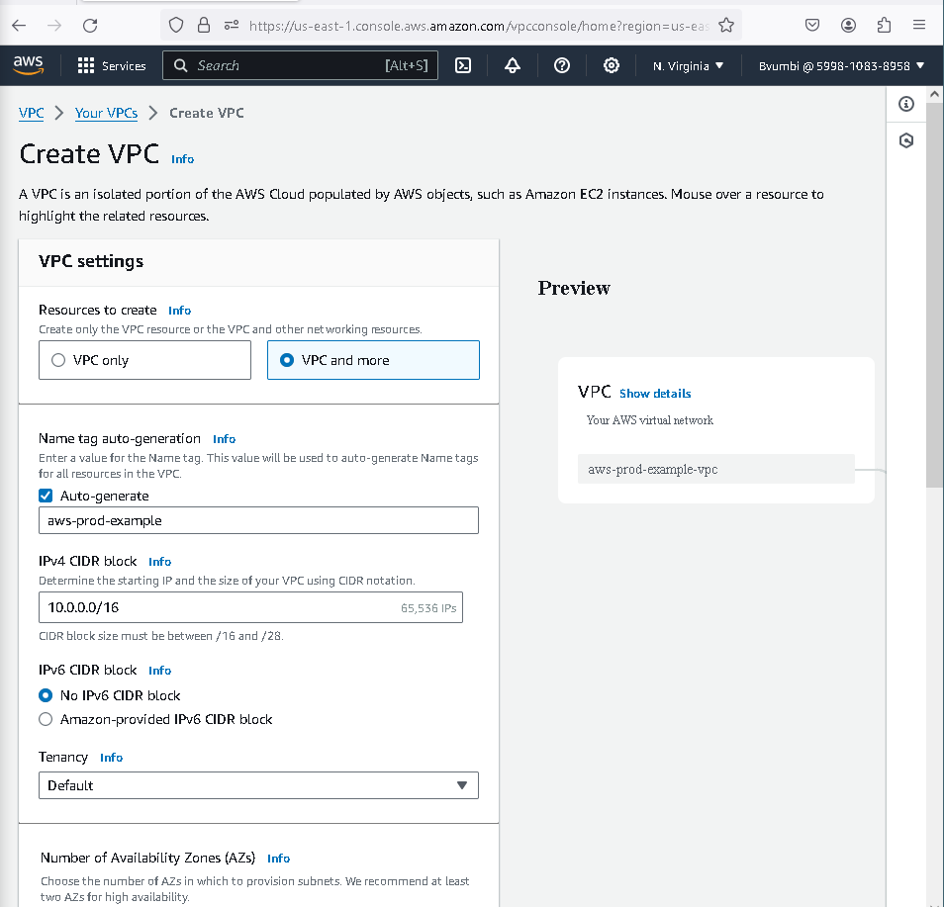
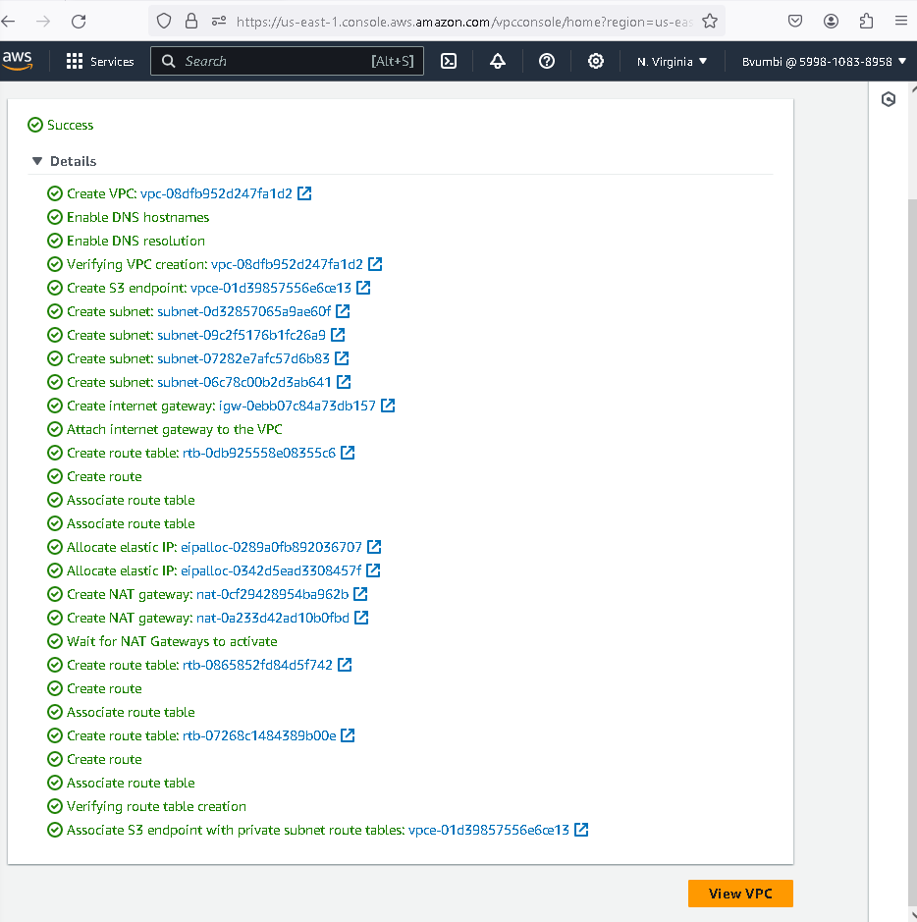
Design and configure a VPC:
Create a VPC with custom IP ranges. Set up public and private subnets. Configure route tables and associate subnets.

Slide 7
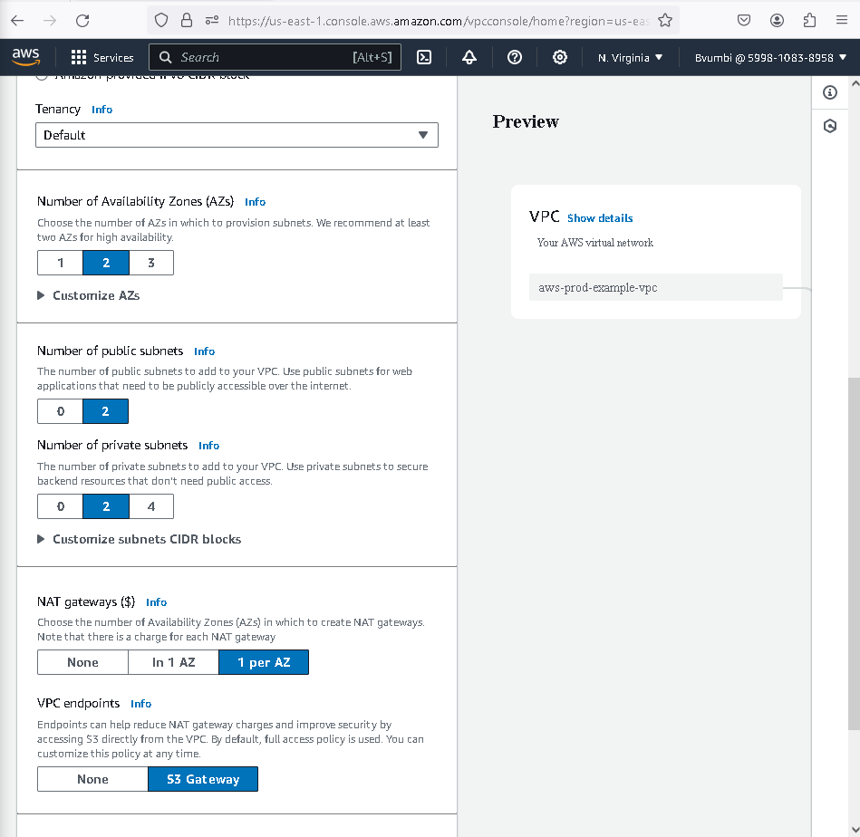
Design and configure a VPC:
Create VPC. Multi-AZ Settings. VPC Creating. VPC Creation Success. VPC View

Slide 8
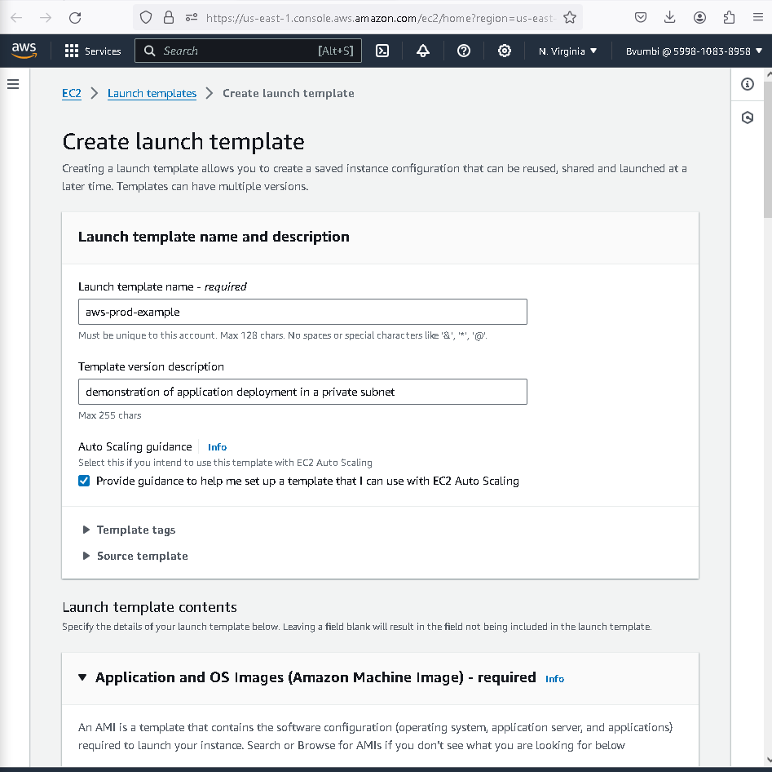
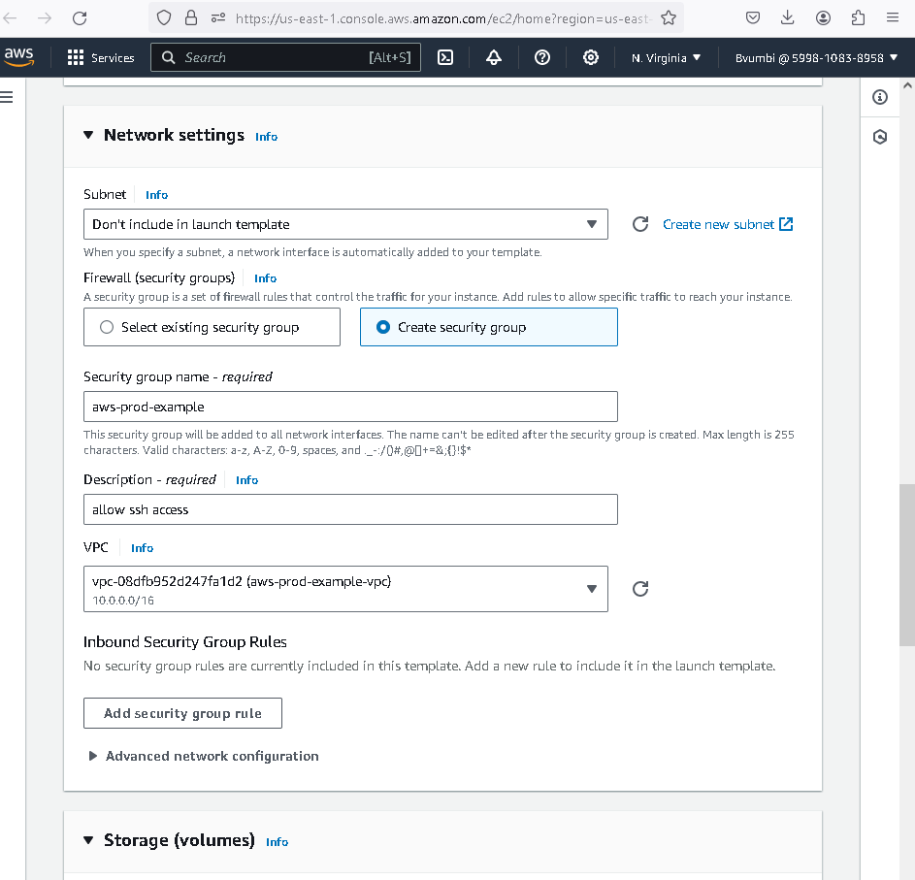
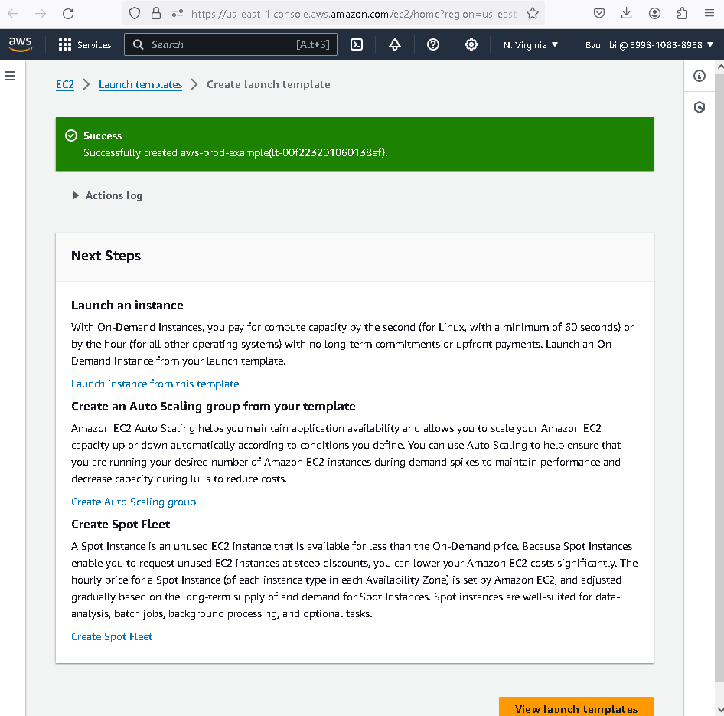
EC2 Instance Group setup:
EC2 Launch Template Setup. Security Group Setup. EC2 Instance Creation

Slide 9
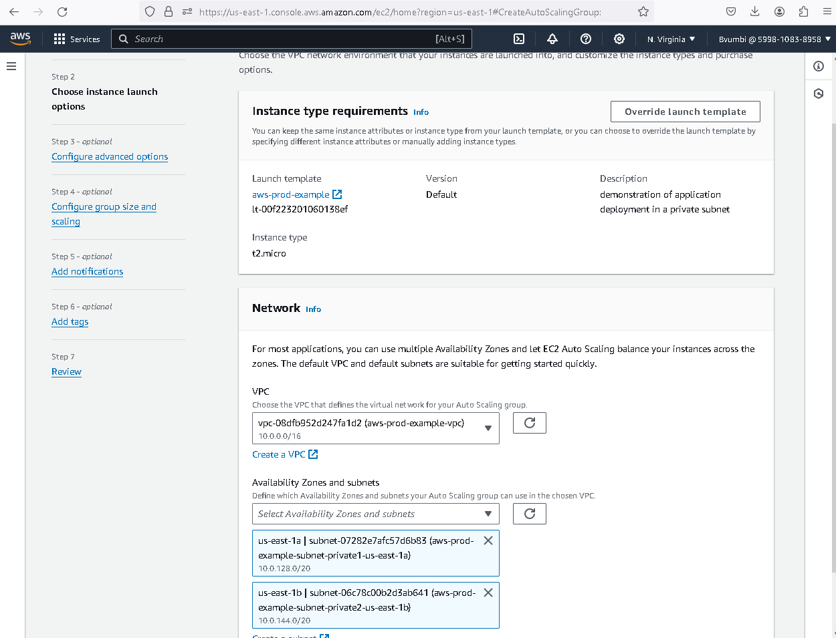
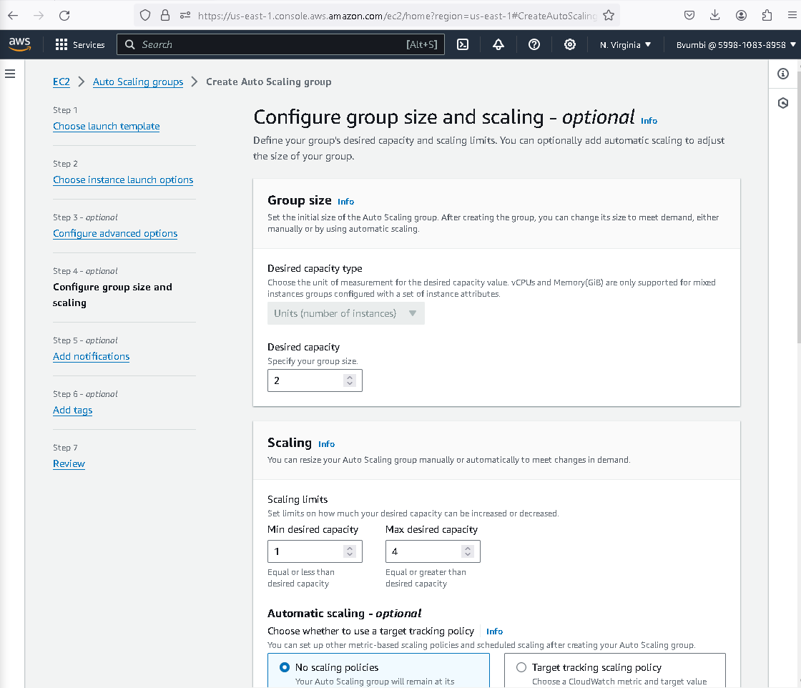
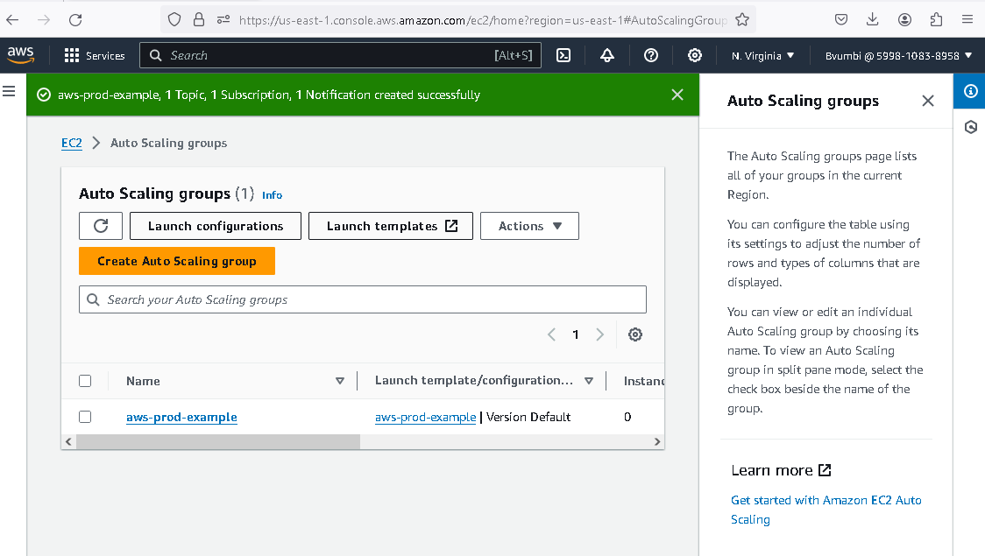
Auto scaling group setup
ASG Setup. Assigned to Private Subnets. Max and Min Limit Settings
SNS Setup for EC2 Instances. ASG Creation Success

Slide 10
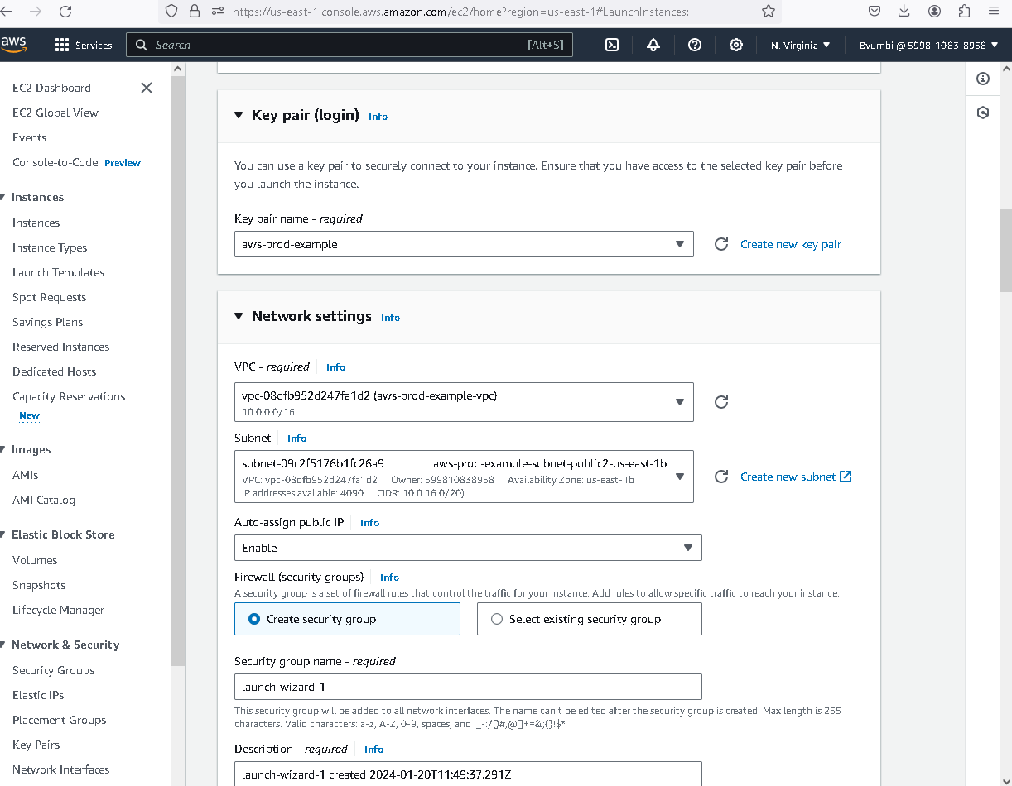
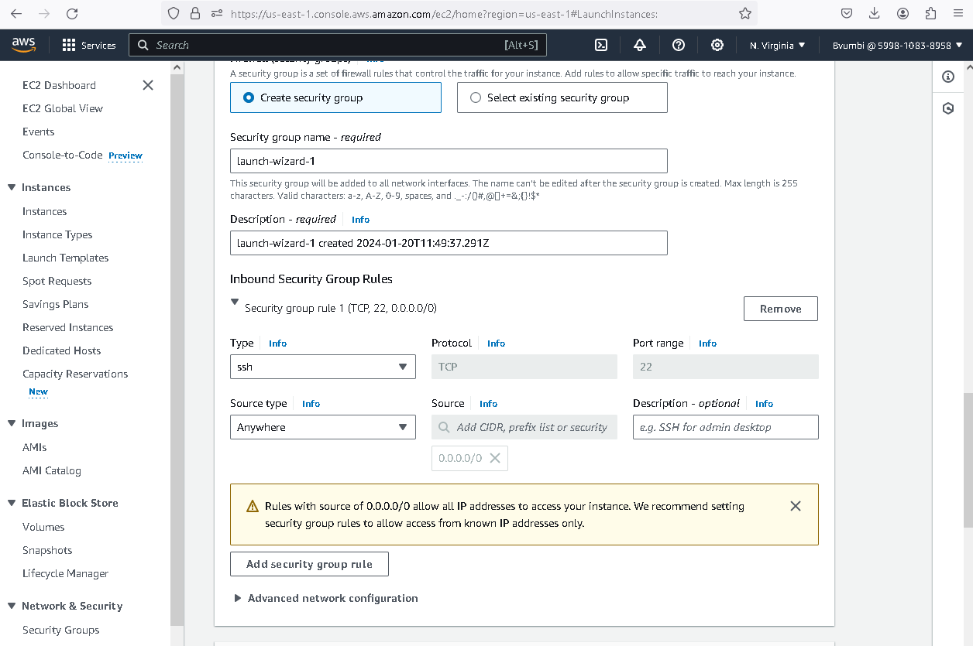
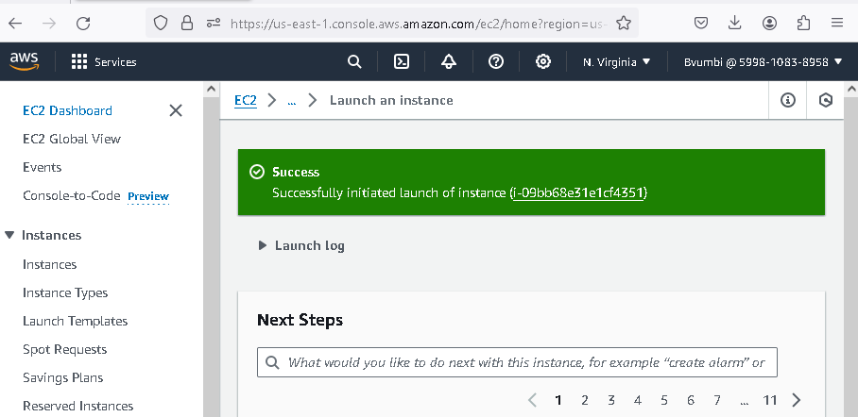
Bastion host setup
Bastion Host Setup. Public IP and Subnet Assigning. Firewall Setting. Host Creation Success

Slide 11
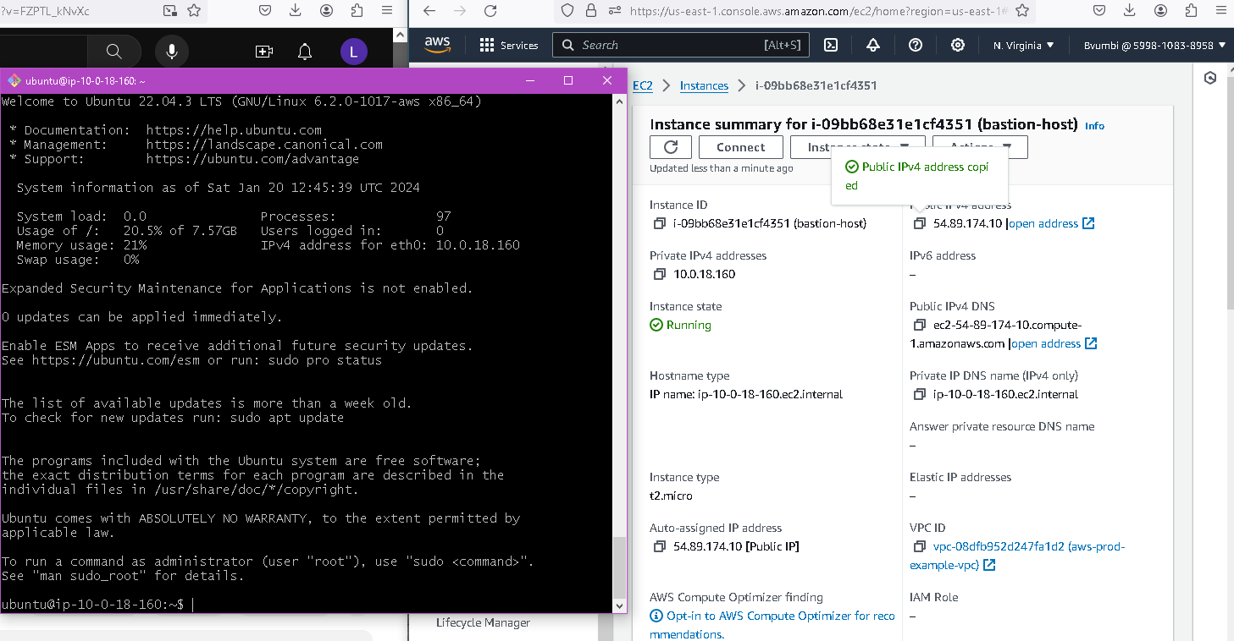
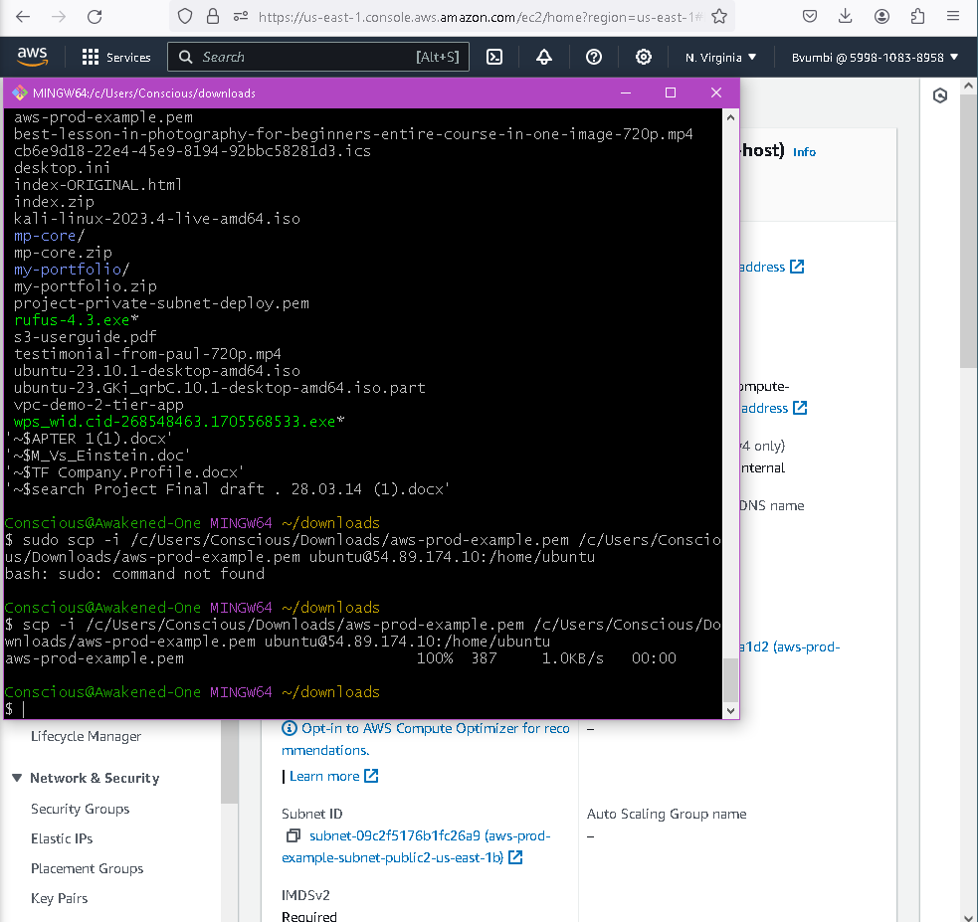
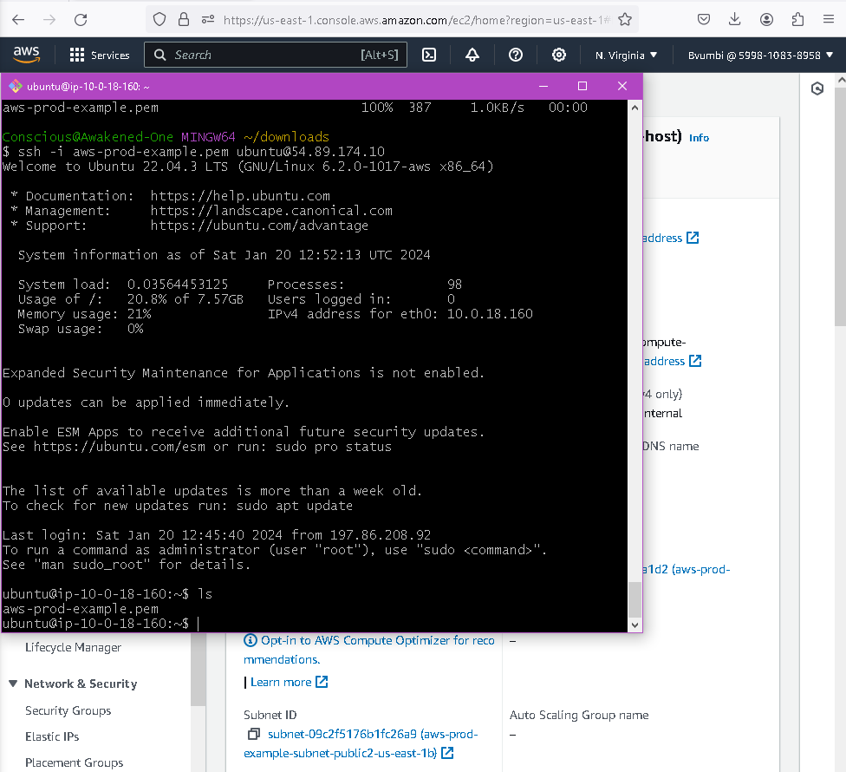
Bastion host setup
Copying Key Pair from Laptop to Bastion Host
Logged In to Bastion Host from Laptop. Key Pair Copying to Bastion Host Success
Confirmed Key Pair on Bastion Host

Slide 12
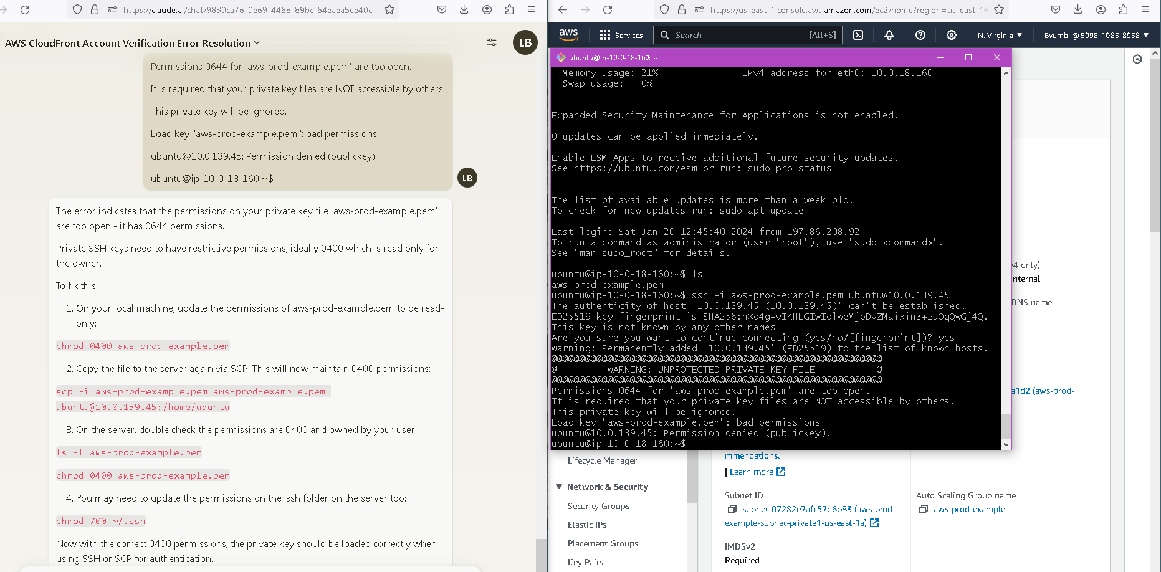
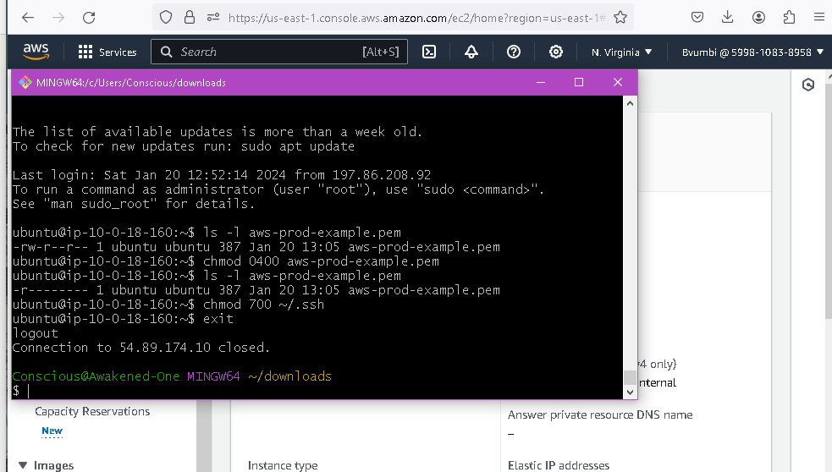
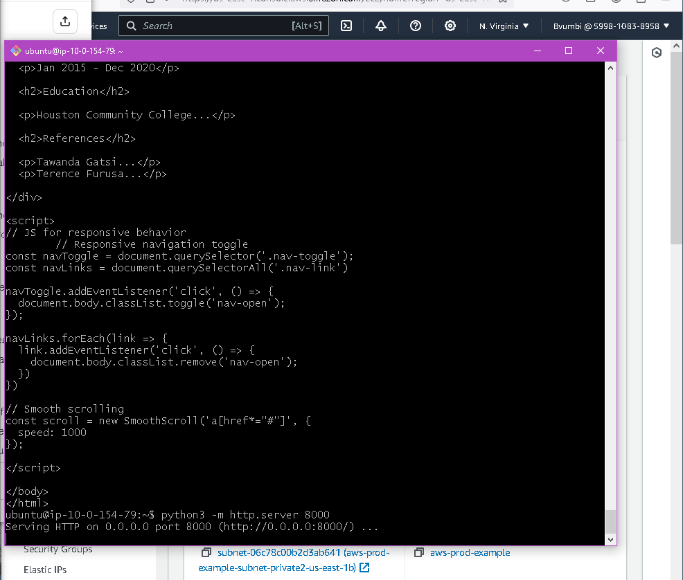
Connecting to private ec2 server from bastion host
Encountered a Public Key Permission Denied Error when connecting to Private EC2 from bastion host.
Changed Permissions of key to read only on laptop and bastion server
Logged in Private EC2 to install python 3 and ran web server successfully

Slide 13
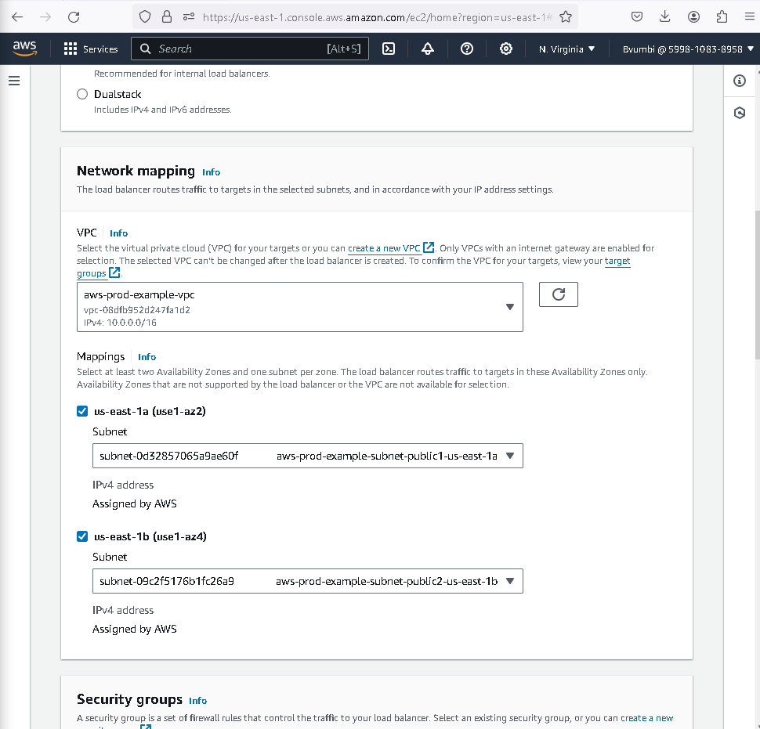
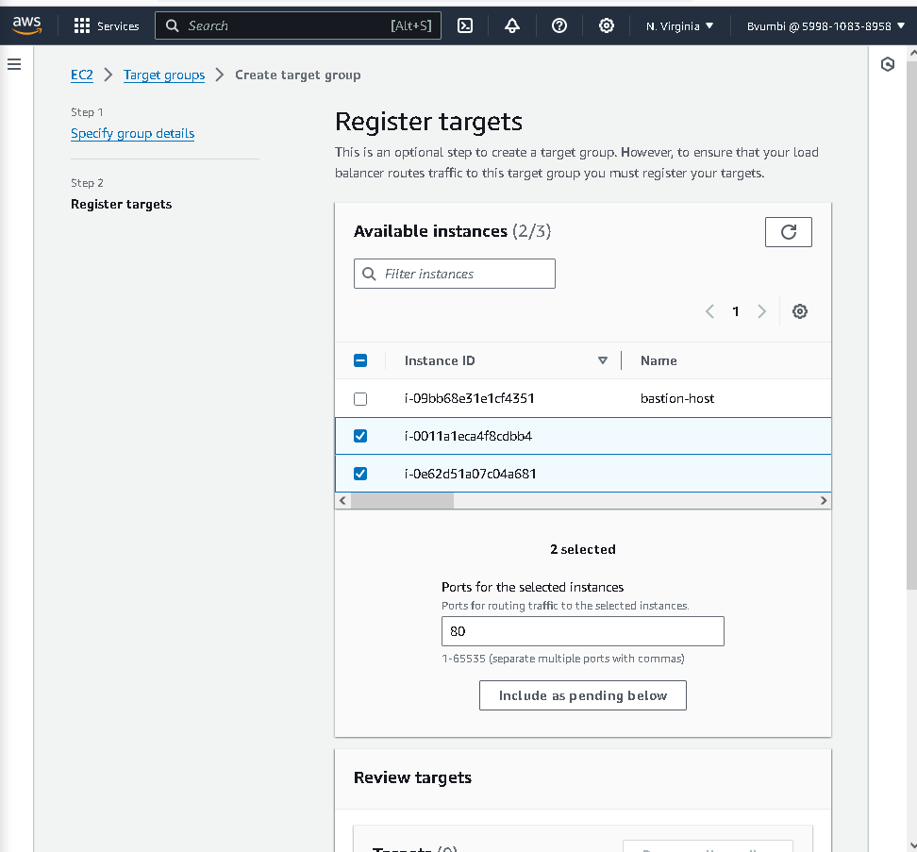
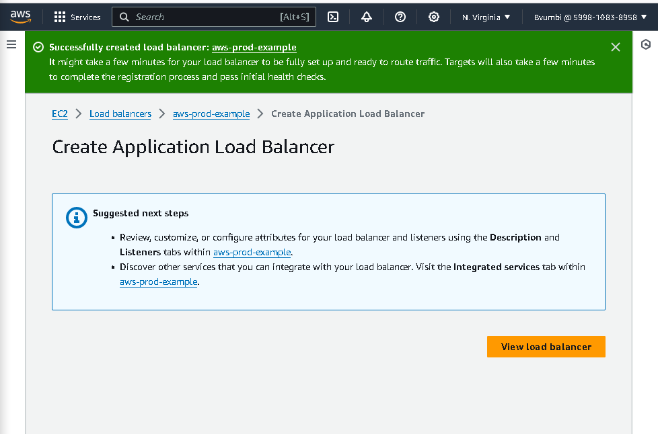
Application load balancer setup
ALB Setup. VPC and Public Subnet Settings. Adding Security Group to ALB
Adding EC2 instances to Target Group. Target Group Setup Success
ALB Setup Successful

Slide 14
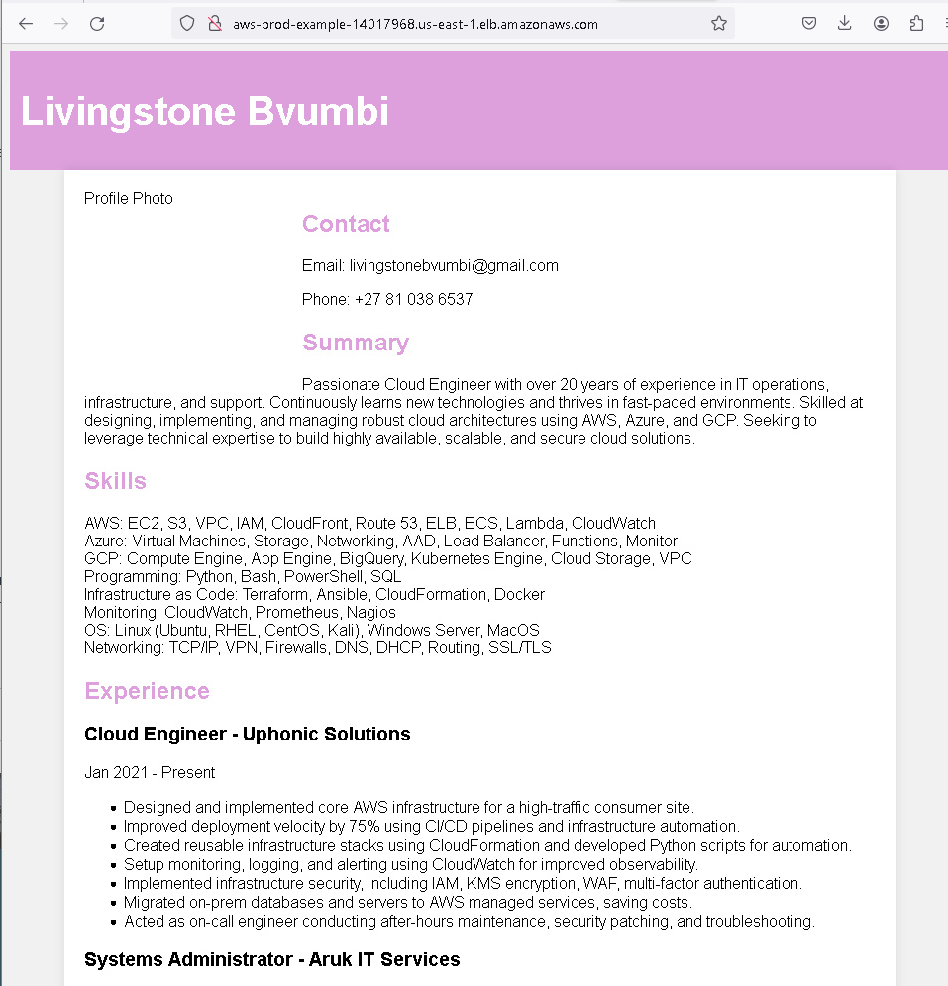
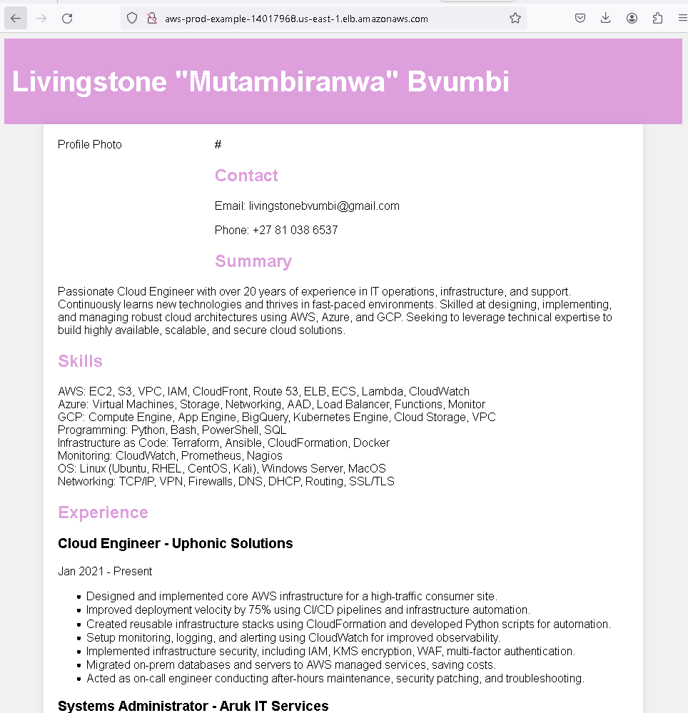
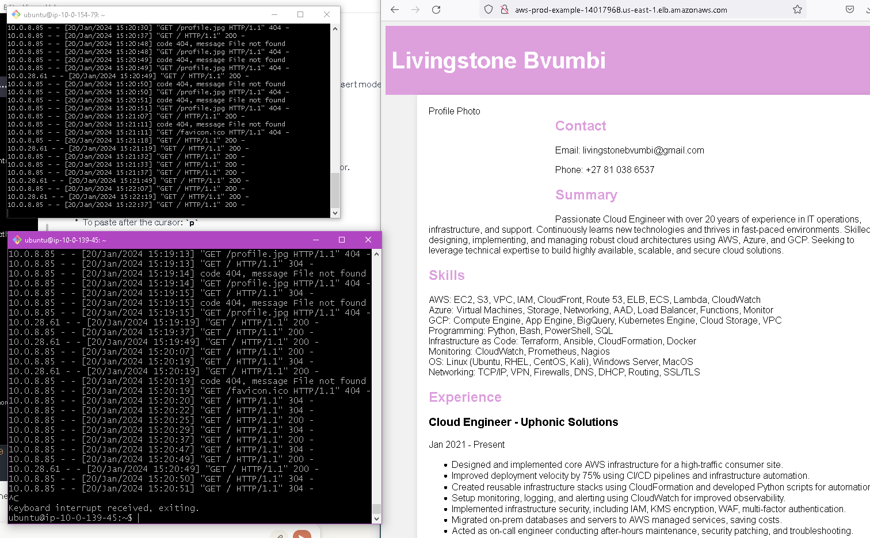
Application running successfully!!!
Online Resume hosted on Private Web Server Displaying Successfully in Web Browser
VPC is securely setup. Application Load Balance in Public Subnet connecting to EC2 servers in Private Subnet
Auto Scaling Group running scalable instances in two AZs making application highly available
The two versions of resume prove that the load balancer is distributing traffic between the EC2 instances

Slide 15



THANK YOU
Livingstone Bvumbi
Cloud Engineer
AWS Certified Solutions Architect Associate
+27 81 038 6537
livingstonebvumbi@gmail.com
https://github.com/Bvumbi/AWS

